Slide 1
ECON*2100 Economic Growth and Environmental Quality
Climate Change Lectures
II. Economics

Slide 2
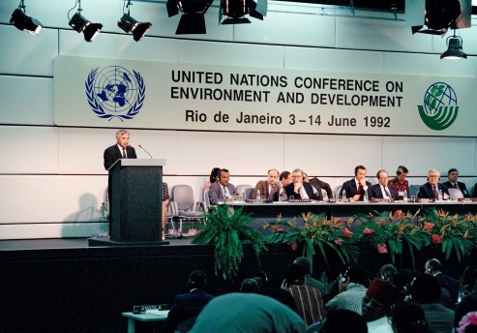
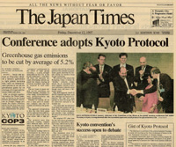
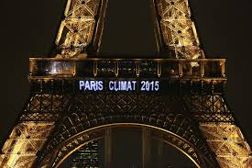
25 years and counting…
1992 (Rio)
Kyoto (1997)
Paris (2015)

Slide 3
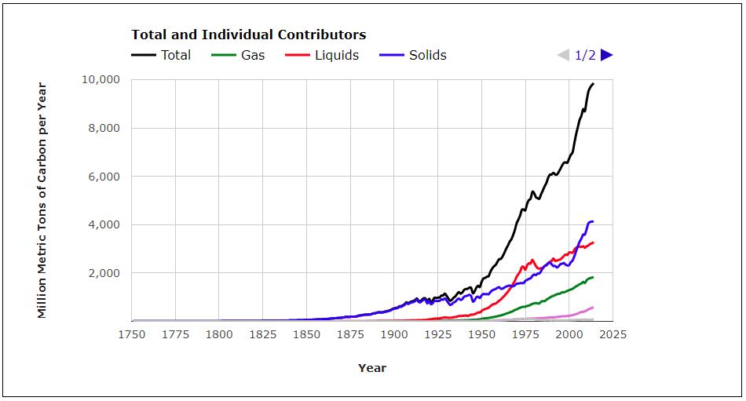
Global CO2 Emissions
Since 1750

Slide 4
What makes this so difficult?
Emissions mix globally so unilateral action is useless – free rider & leakage problems
Concentrations only change very slowly in response even to large emission changes
Emissions are closely tied to fossil use which is essential for economic growth and development
Abatement options are very limited
Effects are highly uncertain and may not appear for decades

Slide 5
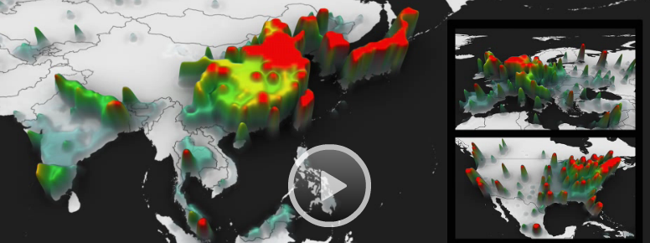
1. Emissions mix globally
Everyone’s responsible for a bit
No one country can change total emissions
Leads to free-rider and leakage problems

Slide 6
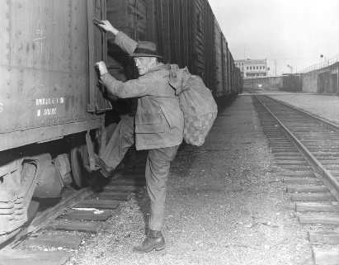
Free Rider Problem
A “tragedy of the commons” problem
If everyone is contributing part of the problem, everyone must contribute part of the solution
If everyone else is contributing to the solution, and I just “free ride” on efforts of others, I get all the benefits and none of the costs

Slide 7
Carbon leakage
Picture 2 regions: A and B
Each has 100 units of emissions
Region A cuts emissions by 50 units
But the policies increase costs for businesses in region A, so they relocate to B where there are no restrictions
Emissions in B go up
So now A has 50 units of emissions and B has 125 units
50% “leakage rate” – half the reductions in A offset by increases in B
A
B

Slide 8
Carbon leakage
Picture 2 regions: A and B
Each has 100 units of emissions
Region A cuts emissions by 50 units
But the policies increase costs for businesses in region A, so they relocate to B where there are no restrictions
Emissions in B go up
So now A has 50 units of emissions and B has 125 units
50% “leakage rate” – half the reductions in A offset by increases in B
A
B

Slide 9
Carbon leakage
Suppose OECD countries cut emissions
Carbon-intensive industries might move to China or India
Leakage rates have been estimated anywhere from 10% to 130%

Slide 10
2. Effects of Kyoto Protocol
Assuming full compliance
Without
With
Notes:
From Wigley, T.M.L. (1998). “The Kyoto Protocol: CO2, CH4 and climate implications.” Geophysical Research Letters 25(13), 2285-2288

Slide 11
2. Effects of Kyoto Protocol
Full compliance with Kyoto would only slightly slow down the rate of accumulation of CO2 in the atmosphere
Year 2100 concentration would be reached in 2105 instead
Yet Kyoto was too costly to implement and few countries complied
Treaty expired in 2012 and has not been replaced

Slide 12
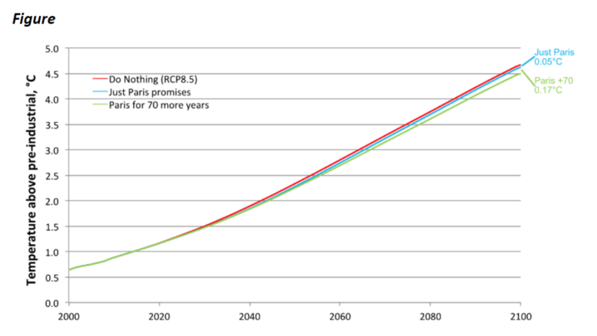
Paris: Government Pledges
Like Kyoto, no noticeable effect
Notes:
Lomborg http://onlinelibrary.wiley.com/doi/10.1111/1758-5899.12295/full

Slide 13
Measuring benefits of abatement
This is the appropriate measure
Costs of GW if there are no abatement policies
Costs of GW if there
are abatement policies
$
Not the
appropriate measure of the benefits of cutting CO2 emissions

Slide 14
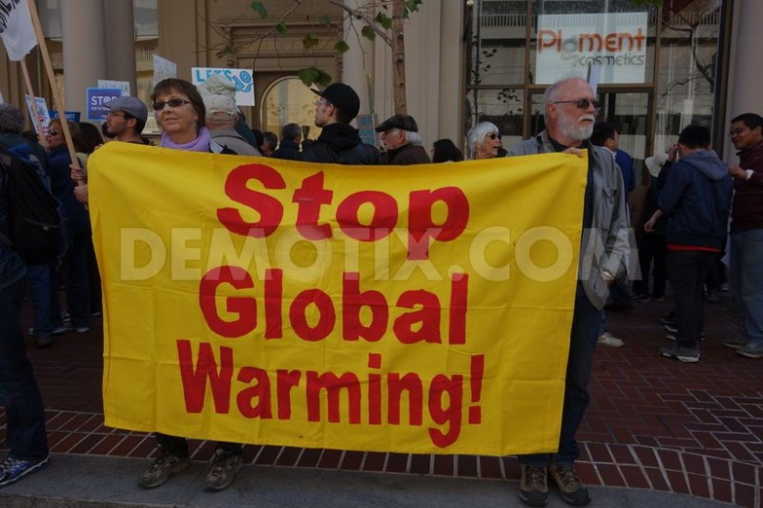
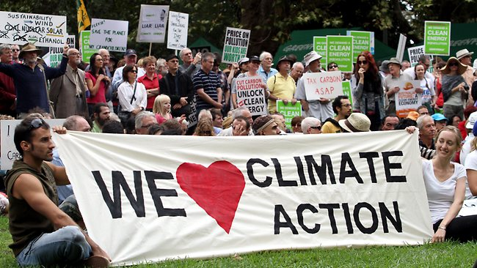
Benefits of Kyoto
Benefit = the discounted value of a slight delay in reaching CO2 doubling
Demands to “stop climate change” or “take action on the climate” aren’t meaningful since emission control policies would only change the timing by a small amount

Slide 15
The key problem
Policies need to be implemented on a very large scale to have a noticeable effect
No one has ever proposed or implemented a policy that would actually “stop” climate change
So far, policies that were too small to have an effect turned out to be too costly to implement (e.g. Kyoto)
Increasing the scale of the policies pushes the costs up faster than the benefits

Slide 16
The key problem
The situation seems to look like this:
$
MAC
Policy Proposal
MD
Emissions

Slide 17
3. Emissions tied to growth
IPCC high emissions growth scenarios:
Developing countries become 10-67x wealthier by 2100 than they are today
Cumulative emissions

Slide 18
3. Emissions tied to growth
In other words…
High growth path implies developing countries achieve an average annual per capita income of almost $70,000 as of 2100
This path solves every development problem known to humanity, yet is deemed a “worst-case scenario”

Slide 19
3. Emissions tied to growth
Which is better…
Rich and warm
Definitely poor but maybe a bit less warm

Slide 20
4. Abatement Options Limited
CO2 closely tied to fossil fuels
Abatement typically very expensive or not possible
Contrast SO2 and CO2:
 |  | Availability
Abatement Option | Relative Cost | SO₂ | CO₂
Scrubbers | Low | Yes | No
Switch to cleaner version of same fuel | Low | Yes | No
Switch to different fuel | High | Yes | Yes
Reduce overall consumption | High | Yes | Yes

Slide 21
5. Effects are uncertain
CO2 is not a regular air pollutant
Natural part of the atmosphere and respiration
Good for plants
Not regulated before now
The concern now is effect on climate
The problem is, “climate” is a catch-all term
People try to link any bad climatic event to CO2 emissions

Slide 22
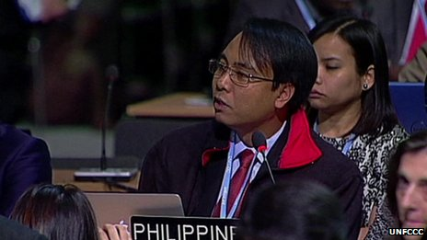
Example: Typhoon Haiyan
Hit Philippines in 2013
Devastating impacts
At UN Climate Conference in Warsaw, Philippine delegate said:
“What my country is going through as a result of this extreme climate event is madness, the climate crisis is madness. We can stop this madness right here in Warsaw.”

Slide 23
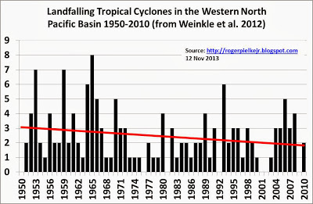
Example: Typhoon Haiyan
It does not imply we are unsympathetic to the suffering of people in the Philippines to point out that what this man said is untrue:
Typhoons have been occurring since long before fossil fuels were used
No individual tropical cyclone can be directly attributed to climate change
Nothing being discussed in Warsaw would have any effect on Pacific typhoons
If anything there is a downward trend in Pacific Basin since 1950s
Notes:
http://rogerpielkejr.blogspot.co.uk/2013/11/are-typhoon-disasters-getting-more.html
http://www.aoml.noaa.gov/hrd/tcfaq/G3.html

Slide 24
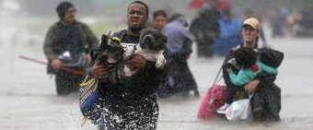
US 2017 Hurricane Season
Houston, Puerto Rico, etc
Was this unusual?
US data on landfalling hurricanes:
1851-1960: 15-24 per decade
1-10 major (Cat3 or higher)
1961-2010: 12-19 per decade
4-7 major
Since 2011, only 3, 2 of which were major
Notes:
http://www.nhc.noaa.gov/pdf/nws-nhc-6.pdf

Slide 25
But suppose there is a connection
After reducing CO2 emissions, there will still be typhoons over the next 100 years, as well as rain, wind, storms, dry spells, etc
Suppose there had been 10% less CO2 emitted in 1963: how would today’s weather be different? - It is impossible to say
Likewise, while we know that emission cuts today will have, at most, very small effects 50 years from now, it is impossible to say what the effects would be

Slide 26
But suppose there is a connection
And if we can’t identify the changes, we can’t put a value on them
All we can say is that they will be small and will happen a long time in the future.

Slide 27
Discounting
A benefit of $1 million 100 years from now, discounted at 5% interest, is only worth $7600 today
So the small uncertain benefits of reducing CO2 emissions must also be discounted because they occur far in the future
But the costs are visible and apparent today
The combination makes it very difficult to motivate incurring costs to reduce CO2 emissions

Slide 28
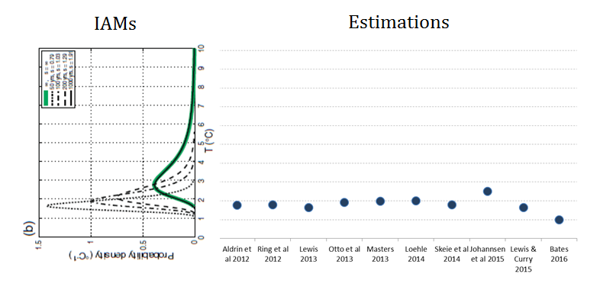
Uncertainty about ECS
Models
Estimations

Slide 29
Uncertainty about ECS
“Integrated Assessment Models” used to compute Marginal Damages (“Social Cost of Carbon”
Equilibrium Climate Sensitivity from climate models used in IAMs
What if we use empirically-estimated ECS instead?

Slide 30
Avg of DICE and FUND
Avg SCC Estimate out to 2050 drops 40-80%
Notes:
Dayaratna, Kevin, Ross McKitrick and David Kreutzer (2016) Empirically-Constrained Climate Sensitivity and the Social Cost of Carbon. Climate Change EconomicsApril 2017 DOI: http://dx.doi.org/10.1142/S2010007817500063

Slide 31
Summary
Emissions mix globally so unilateral action is useless – free rider & leakage problems
Concentrations only change very slowly in response even to large emission changes
Emissions tied to fossil use which is essential for economic growth and development
Abatement options are very limited
Effects are highly uncertain and may not appear for decades

