Slide 1
ECON*2100 Week 2 – Lecture 1
Models of Economic Growth:
Smith & The Classics

Slide 2
What do we mean by growth?
Extensive growth: output only grows because inputs grow
Output keeps up with population
Intensive growth: output grows faster than inputs
Per capita income rises
This requires output per worker to rise

Slide 3
Output per worker
Maddison p. 13: (UK, USA, Japan)

Slide 4
Maddison: Basis of European Expansion 1000-1820
Rise of scientific outlook
Supported by technological innovation in book publishing
Rise of trading centres
Supported by institutional developments that made contracts and account-keeping possible
Adoption of Family Law based on Christian rules
Promoted monogamy and inheritance, leading to buildup of wealth and decline of clan/tribal loyalty
Rise of nation states
Supported by technological progress in shipping

Slide 5
1700s: Theories of Growth
Mercantilist
Growth comes through industrial exports, government should promote these activities
Physiocrats
Growth derives from agriculture alone
Government is a sterile entity in the economy
Smith
Voluntary exchange leads to specialization, which leads to growth

Slide 6
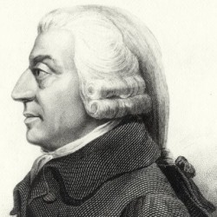
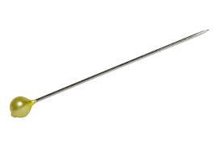
How do economies grow?
Adam Smith, 1776: Specialization and Division of Labour
A workman not educated to [pin-making] could scarce, perhaps, with his utmost industry, make one pin in a day, and certainly could not make twenty. But…one man draws out the wire, another straights it, a third cuts it, a fourth points it, a fifth grinds it at the top for receiving the head… to whiten the pins is another; it is even a trade by itself to put them into the paper; and the important business of making a pin is, in this manner, divided into about eighteen distinct operations… all performed by distinct hands…I have seen a small manufactory of this kind where ten men only were employed…[they] could make among them upwards of forty-eight thousand pins in a day. Each person, therefore, making a tenth part of forty-eight thousand pins, might be considered as making four thousand eight hundred pins in a day.
It is the great multiplication of the productions of all the different arts, in consequence of the division of labour, which occasions, in a well-governed society, that universal opulence which extends itself to the lowest ranks of the people.

Slide 7
How do economies grow?
Specialization and exchange

Slide 8
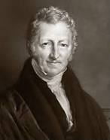
Malthus: Yes, but…
Population growth always exceeds agricultural productivity growth
Hence starvation and subsistence is unavoidable
Population growth rate
ZPG point
0
Income per capita

Slide 9
Classical Model
Based on Malthus
Y = f(L,N)
Diminishing returns to labour
Labour
Land (fixed)

Slide 10
Classical Model
Output per Worker (Y/L) is called ‘g’
At subsistence level, call it g_{z}
Subsistence output = g_{z} $×$L

Slide 11
Classical Model
Output per Worker (Y/L) is called ‘g’
At subsistence level, call it g_{z}
Subsistence output = g_{z} $×$L
Y=g_{z} $×$L
Output Y
Labour L
L_{eq}

Slide 12
Classical Model
Output per Worker (Y/L) is called ‘g’
At subsistence level, call it g_{z}
Subsistence output = g_{z} $×$L
Y=g_{z} $×$L
Output Y
Pop grows
➔
Pop declines
⬅
Labour L
L_{eq}

Slide 13
Summary
Prior to Smith, theories of economic growth weren’t very sensible (though they still get around)
Smith: specialization and trade are key to economic growth
Malthus: Yes, but we’re doomed to starvation and subsistence anyway
Classicals: Diminishing returns to labour means a fixed labour supply at subsistence wages

Slide 14
Next
Solow growth model: the importance of capital investment

