Slide 1
ECON*2100 Week 2 – Lecture 2
The Solow Growth Model

Slide 2
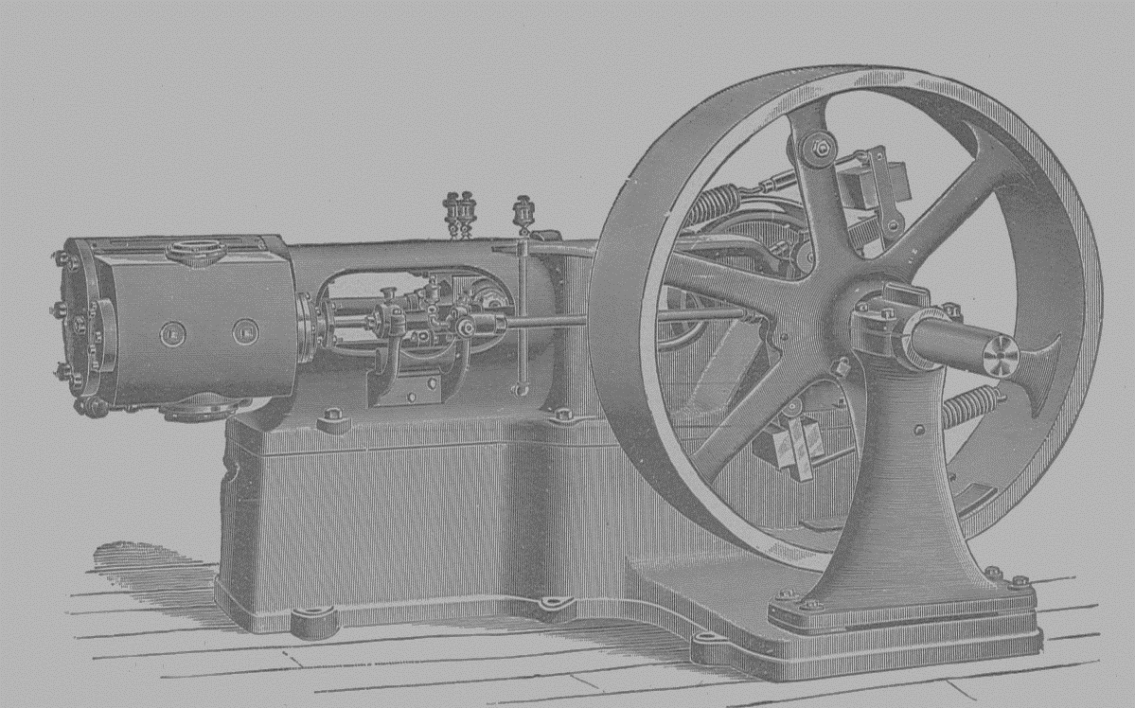
After Smith
Industrial revolution in 1800s, invention of steam engine
Various writers recognized that investment and capital formation mattered
1930s: Keynes argued that increasing Aggregate Demand and consumption were necessary to achieve growth
1950s: Solow argued that savings, not consumption, drives growth

Slide 3
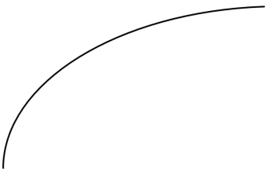
Basic set-up
Production function
$$Y=A×K^{a}×L^{b}$$
where $a+b=1$
(which implies $b−1=−a$)
Y = output
K = amount of capital
L = amount of labour
A = productivity (know-how, technology)
Y
L

Slide 4
Basic set-up
Re-express in per-worker terms:
$\frac{Y}{L}=\frac{A×K^{a}×L^{b}}{L}$
$$\frac{Y}{L}=A×K^{a}×L^{b−1}$$
$$=A×K^{a}×L^{−a}$$
$=A×\frac{K^{a}}{L^{a}}$
$$\frac{Y}{L}=A×{\left(\frac{K}{L}\right)}^{a}$$

Slide 5
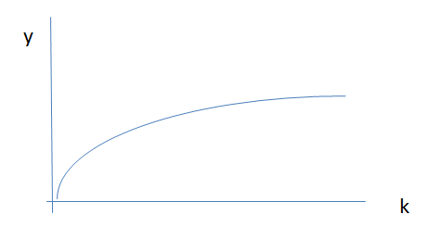
Basic set-up
Use lower case to denote “per worker”
y = output per worker (Y/L)
k = capital per worker (K/L)
$$y=Ak^{a}$$
Diminishing returns to
capital

Slide 6
Savings and Investment
At each period t, income is either used for consumption C or investment I
$$Y_{t}=C_{t}+I_{t}$$
$$y_{t}=c_{t}+i_{t}$$
d % of capital disappears due to depreciation
So next period (t+1), capital is
$k_{t+1}=k_{t}−d×k_{t}+i_{t}$

Slide 7
Savings and Investment
Savings is the part of income Y not spent on C
$$s_{t}=y_{t}−c_{t}$$
Note: $y_{t}=c_{t}+i_{t}$,
so $i_{t}=y_{t}−c_{t}=s_{t}$
Thus investment equals savings: $i_{t}=s_{t}$

Slide 8
Capital dynamics
Suppose savings is always fraction v of income
$$s_{t}=v×y_{t}$$
Also suppose $a=0.5, v=0.1$ , $A=100$ and $d=0.1$, $k_{0}=100$
Capital dynamics equation:
$k_{t+1}=k_{t}−d×k_{t}+v×A{\left(k_{t}\right)}^{a}=k_{t}−0.1k_{t}+10k_{t}^{0.5}$

Slide 9
Economic Growth
Period 0:
$k_{0}=100$
$y_{0}={100(k_{0})}^{0.5}=100×10=1,000$
$s_{0}=0.1×1,000=100$
$c_{0}=1,000−100=900$
Period 1:
$k_{1}=100−0.1×100+100=190$
$y_{1}=100{\left(k_{2}\right)}^{0.5}=1,378$
$s_{1}=0.1×1,378=137.8$
$c_{1}=1,378−137.8=1,240.2$

Slide 10
Economic Growth
Period 0:
$k_{0}=100$
$y_{0}={100(k_{1})}^{0.5}=100×10=1,000$
$s_{0}=0.1×1,000=100$
$c_{0}=1,000−100=900$
Period 1:
$k_{1}=100−0.1×100+100=190$
$y_{1}=100{\left(k_{1}\right)}^{0.5}=1,378$
$s_{1}=0.1×1,378=137.8$
$c_{1}=1,378−137.8=1,240.2$

Slide 11
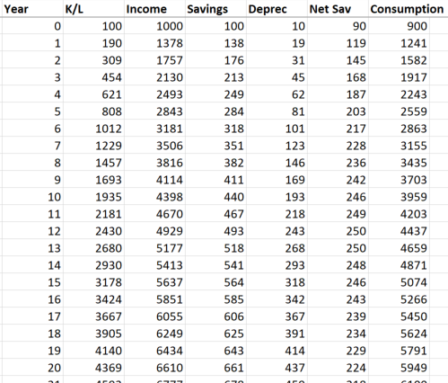
Economic Growth
Subsequent periods:
Depreciation grows linearly with capital but income and savings grow at a diminishing rate
So net savings peaks early then goes towards zero

Slide 12
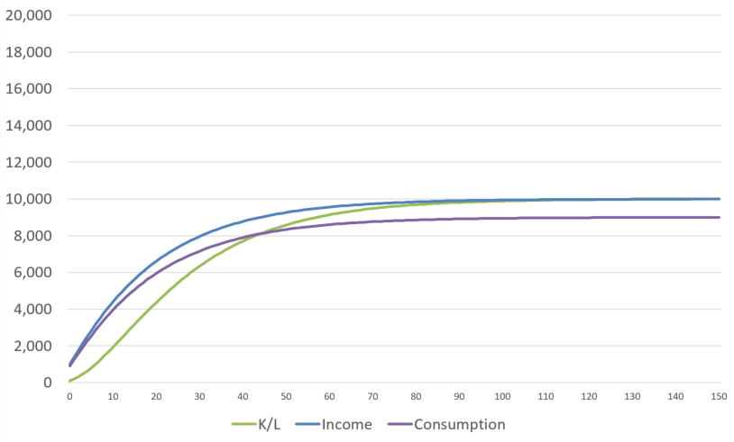
Economic Growth
Subsequent periods:

Slide 13
Steady State
k stops growing: investment = depreciation
Steady state capital stock: $k_{t+1}=k_{t}≡k_{s}$
Can solve $k_{s}=k_{s}−dk_{s}+vA{\left(k_{s}\right)}^{a}$ to get
$$k_{s}={\left(\frac{vA}{d}\right)}^{\frac{1}{1−a}}$$

Slide 14
Steady State
$$k_{s}={\left(\frac{vA}{d}\right)}^{\frac{1}{1−a}}$$
Steady state income: $y_{s}=A{\left(k_{s}\right)}^{a}$
Steady state consumption $c_{s}=y_{s}−vy_{s}$
Does not depend on $k_{0}$!
Mainly depends on savings rate (v) and productivity parameters (A,a)

Slide 15
Implications
Starting capital stock doesn’t determine outcome
Savings rate and productivity (technology) are key to growth
Low-income countries should grow rapidly compared to high-income countries
Countries with similar technology and savings rates will converge to similar income levels

Slide 16
Next
Population Growth

