Slide 1
ECON*2100 Week 2 – Lecture 3
Population Growth

Slide 2
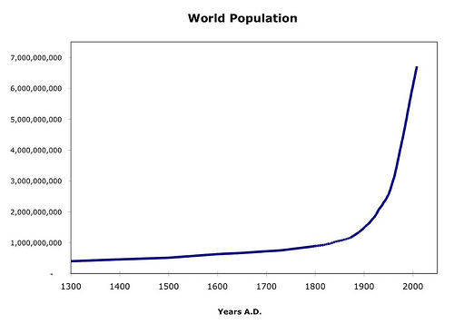
World Population

Slide 3
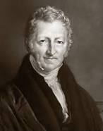
The Malthusian View
Malthus: feasible limit grows slowly

Slide 4
The Malthusian View
Malthus: feasible limit grows slowly
Number alive
Number that can be fed

Slide 5
The Malthusian View
Malthus: feasible limit grows slowly
Number alive
Number that can be fed

Slide 6
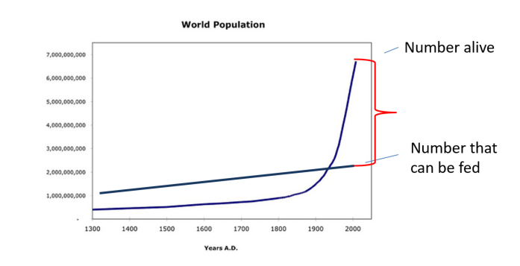
Problem with the Malthusian Model
He underestimated society’s capacity to increase production of food and other essentials
Predicted mass starvation and death of excess population

Slide 7
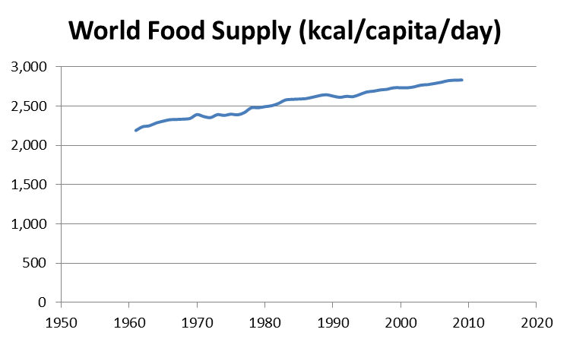
Food output
Advances in agricultural productivity
Equipment
Plant breeding (Green Revolution)
GMO

Slide 8
Demographic transition
3 countries 1820-2009:
Each experiences a leveling off

Slide 9
General pattern
Initially: High birth rate, high death rate
People
Population growth rate
Time

Slide 10
General pattern
Next: Birth rate stays high, but death rate falls
People
Population growth rate
Time

Slide 11
General pattern
Next: Birth rate falls
People
Population growth rate
Time

Slide 12
General pattern
Next: Birth rate falls
People
Population growth rate
Time

Slide 13
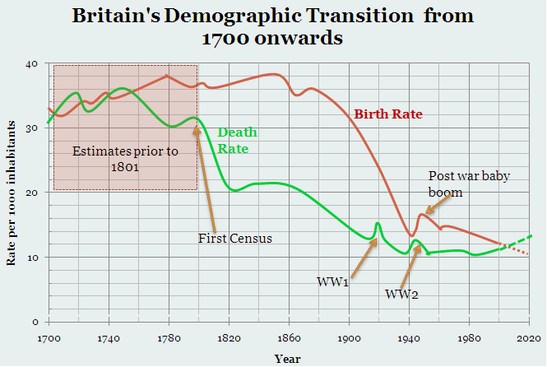
Britain

Slide 14
World Population

Slide 15
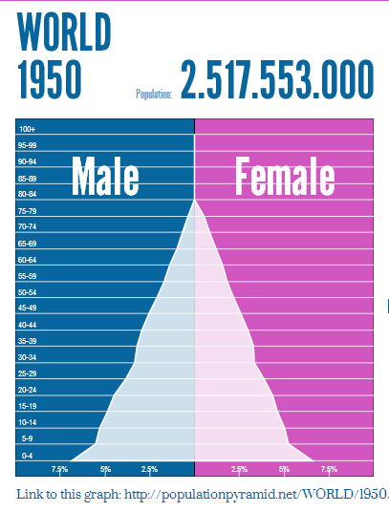
Population pyramid
Populationpyramid.net

Slide 16
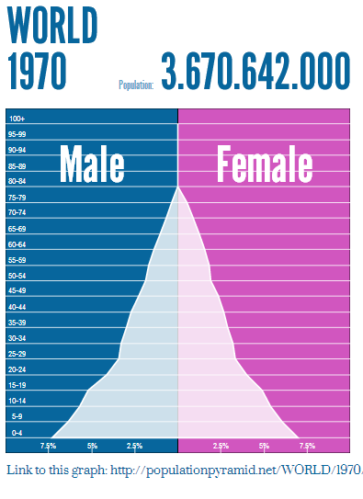
Population pyramid
Populationpyramid.net

Slide 17
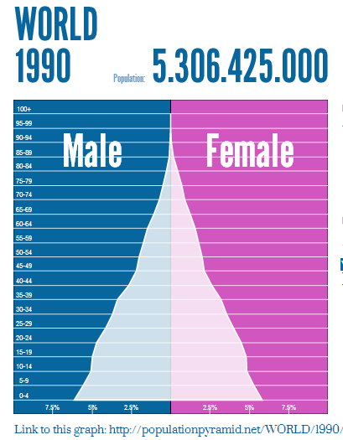
Population pyramid
Populationpyramid.net

Slide 18
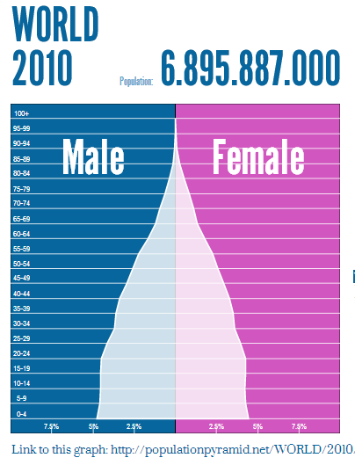
Population pyramid
Populationpyramid.net

Slide 19
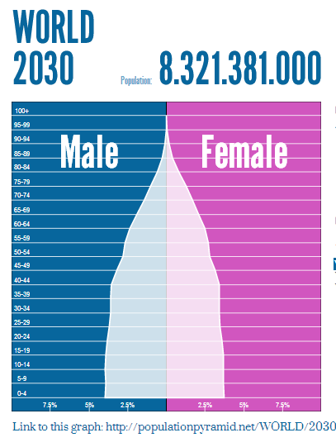
Population pyramid
Populationpyramid.net

Slide 20
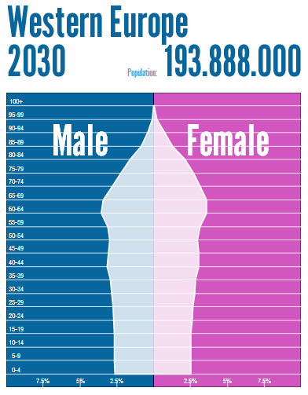
The Problem for the West
Dependency ratio

Slide 21
“Overpopulation”
Are there too many people in the world?

Slide 22
Overpopulation debate
The ‘Yes’ view:
3rd World cities are teeming with crowded, overflowing slums
Pressure on resources, leading to local deforestation and pollution
As large countries like India and China industrialize, their energy use and pollution emissions will soar
The only solution is to reduce population

Slide 23
Overpopulation debate
The ‘No’ view:
3rd World is urbanizing but has weak property rights rules in expanding cities, which gives rise to slums
Even small populations can overexploit badly-managed resources.
As large countries like India and China get wealthy, their energy use will get more efficient and pollution emissions will be better managed
Birth rates are falling rapidly around the world and dependency ratios are unsustainable

Slide 24
Next
Resources, Scarcity & Growth

